Slide 1
Business Architecture Metamodel Update
2017 Summit Update

Slide 2
Overview
Business Architecture Framework recap
Business architecture knowledgebase
Knowledgebase and metamodel requirements
Sample metamodel from BIZBOK® Guide
What the Guild is doing to standardize metamodel views

Slide 3
The Value Proposition
Goal – create an international standard for a business architecture metamodel that aligns to / implements the underlying metamodel in the BIZBOK® Guide
The Win – any tool aligned to a standard metamodel based on BIZBOK® Guide can input and export and ideally represent standard business architecture representations as defined by best practices in the BIZBOK® Guide

Slide 4
Business Architecture Framework Relies on Robust Knowledgebase
Knowledgebase
Source of Basic Framework:
(BIZBOK® Guide)
Knowledgebase: Manages business architecture metadata and relationships in easily accessed facility
Blueprints: On demand and ad hoc business architecture diagrams, extracts and reporting
Scenarios: Specific business context shaped by business objectives, related challenges, action items, plans

Slide 5
Knowledgebase is Based on BIZBOK® Guide’s Underlying MEtamodel
Business architecture maps various business domains – which need to be accessible in a wide variety of ways
This perspective is reflected in the BIZBOK® Guide’s Business Architecture Framework
Managing a well-articulated business architecture requires a robust knowledgebase – the centerpiece of that framework
Best practices and emerging standards dictate basic relationships
Repositories, databases and third party software enable management of knowledgebase
Best practices are evolving into standards for managing this information
In all cases a robust metamodel must be established to enable a cross-section of tool vendors and practitioners to represent, exchange and disseminate standard business architecture blueprints and related representations

Slide 6
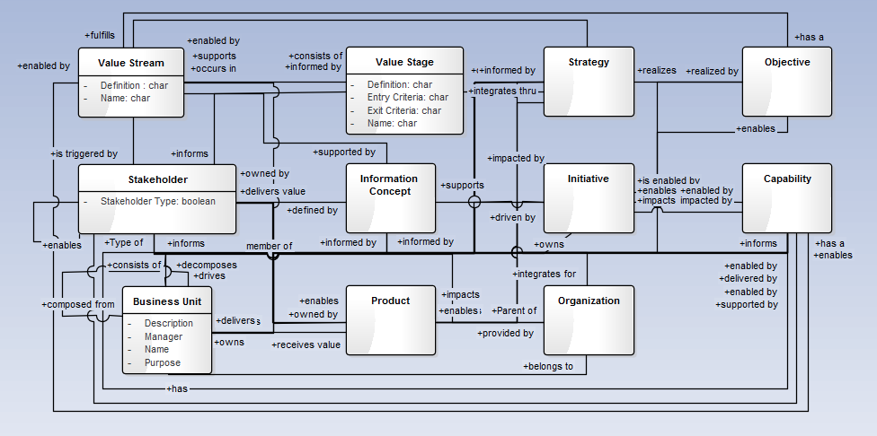
Sample Early Stage Metamodel from BIZBOK® Guide Part 5
Sample metamodel depicting relationships among business architecture artifacts
Source: BIZBOK® Guide Part 5

Slide 7
Current Work in Progress by Guild Metamodel Team
OMG RFP
OMG Discussions ongoing
Response to RFP underway (targeting EOY ‘17)
MM Design
Inviting international participants
Finalizing the Core
Drafting the Penumbra
Vendor Engagement
Collaborating with vendors on MM design
Preparing our first vendor breakfast in Reston
Inviting vendors to join us in a formal submission response

Slide 8
Metamodel Team Roadmap (2017/2018 Timeline)
Q1
Q2
Q3
Q4
Q1
OMG RFP
RFP Response
MM Design
Core
Penumbra
Extensions
BIZBOK® Updates
Vendor Engagement
The team is working on multiple threads. Much work and time was spent in the last 12-18 months incorporating new thinking and approach for the MM, engaging constituencies in OMG to socialize and build consensus towards a BAMM RFP, and working with the vendor community to outline opportunities for ongoing collaboration and participation for the future.

Slide 9
Capability as the centerpiece
Capability is the natural starting point for a BA because it describes “what” a business does in a way that supports analysis of various related business management concerns by:
Engaging business and operational stakeholders about their relevant concerns (current state), and
Guiding them towards a progressive set of steps to achieve their goals and objectives (strategy) for the short term and over the long term (future states)

Slide 10
Layered view of MetaModel (bizbok®)

Slide 11
First 2 layers of MM
Penumbra
Business Strategy Mapping
Initiative Mapping
Product Mapping
Stakeholder Mapping
Policy Mapping
BPM and Management
Case Management
Business Performance Mgmt.
Requirements Alignment
Core
Capability – Centerpiece defines WHAT the business does
Value – defines WHY the business has the capabilities
Information – HOW we build alignment between Capability, Value, and Organization
Organization – HOW we align resources to deliver value

Slide 12
RFP View of Business Architecture Metamodel Response Requirements
Capability required
Other representations desired
Must interface with existing standards
Capability Oriented Business Perspective

Slide 13
Scenario-Driven BA Meta Modeling
The BA MM was derived from the practitioners of Business Architecture and the organizations by leveraging common business scenarios:
Investment Analysis
Shift to Customer Centric Business Model
Merger & Acquisition Analysis
New Product/Service Rollout
Globalization
Business Capability
Outsourcing
Supply Chain Streamlining
Divestiture
Regulatory Compliance
Change Management
Operational Cost Reduction
Joint Venture Deployment

Slide 14


Vendor Engagement
Variations for candidate metamodel have been adopted, are under review for adoption, or have been or are being user implemented across numerous tool vendors
Candidate metamodel is based on the concepts captured across practitioner communities, as embodied in the BIZBOK® Guide, which has wide adoption across government, institutions, commercial, and non-profit (US & International)
Next steps – Guild will engage with vendor community in more focused ways to submit a response to the OMG RFP

Slide 15
Related Standards and Tool WOrk
Guild engaged with OMG for long-term to work on rollout and evolution of a standard metamodel
Guild also a member of Open Group to influence TOGAF® and its content model
Guild team has created a UML Profile for BIZBOK® for UML based tools
This could be standardized as well and aligns to the Guild metamodel

Slide 16
Thank you
We are looking for additional participants to accelerate
our efforts on this landmark work plan. Please contact the
Team Leader (Jeffrey Wallk) on the Guild Site (see link)
(http://www.businessarchitectureguild.org)

